Slide 1
JSHint - A Javascript static Analysis Tool
Guangwei(Joe) Qiao
Software Engineer

Slide 2
Agenda
1
JSHint Overview
2
JSHint Usage
3
How to Integrate JSHint with Maven
4
How to Integrate JSHint with Jenkins
Q & A
5

Slide 3
Main Factors for High Code Quality
Unit Test
Code Coverage
Code Static Analysis
Notes:
To pursue the quality of code. These three aspects should be considered.
Fortunately, we have adopted many amazing tools into developing and building environments.
For example, TestNG, Jmokit for Java Unit Test, Clover for Code Coverage, CheckStyle for Java code static analysis.

Slide 4
JSHint Overview
Community driven and open source in github.
Detect errors and potential problems in javascript code.
For example: 1) detect undefined variables.
2) detect unused variables.
Flexible and configurable.
Provide amazing plugins for Text Editors and IDEs.
For example: Sublime(Text Editor), Eclipse(IDE). Link
Notes:
JSHint is a community-driven tool to detect errors and potential problems in Javascript code. It is very flexible so you can easily customize it to your coding guidelines and the environment you expect your code to execute in.

Slide 5
1
JSHint Overview
2
JSHint Usage
3
How to Integrate JSHint with Maven
4
How to Integrate JSHint with Jenkins
Q & A
5

Slide 6
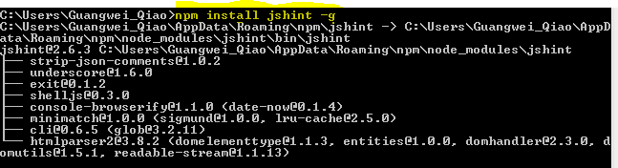
JSHint Base Usuage
Install JSHint as a Node program.
npm install jshint –g
Notes:
The easiest way to use JSHint is to install it as a Node program. To do so, simply run the following command in your terminal npm install jshint –g

Slide 7

JSHint Base Usuage(contd)
Check a single file or all files in a directory
jshint [file name]
jshint [directory name]
Notes:
After you've done that you should be able to use the jshint program. The simplest use case would be linting a single file or all JavaScript files in a directory.
So there will be a question, how can JSHint check javascript code? What criterion JSHint is going to follow?

Slide 8
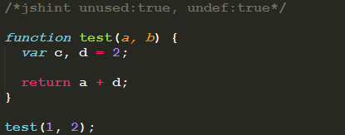
JSHint Configuration(two ways)
Using Configuration File
a) Use a special file .jshintrc (default and recommended)
b) Specify configuration file manually via the --config flag.
Use this format: jshint [file name] --config [config file name]
c) Put your config into your projects package.json file under jshintconfig property.(For Node project)
Inline Configuration
In addition to using configuration files you can configure JSHint within your files using special comments.
Notes:
By default, JSHint will search for a configuration file named ‘.jshintrc’ , all the code checking criterion will be found.
JSHint comes with a default set of warnings but it was designed to be very configurable. You have three methods to configure your copy of JSHint
The third method is recommended, using .jshintrc, JSHint will start looking for this file in the same folder as the files to be linted. If not found, it will move one level up the directory tree all the way up to the file system root. You can make use of this character, place your file into the project root directory and, as long as you run JSHint from anywhere within your project directory tree, the same configuration file will be used.
Take it easy for the options, I am gonna explain them later.

Slide 9
JSHint Configuration (contd)
Configuration file is a simple JSON file that specifies which JSHint options to turn on or off. For example, the following file will enable warnings about undefined and unused variables and tell JSHint about a global variable named “angular” as read-only.
{
"unused" : true,
"undef" : true,
"globals": {
"angular" : false
}
}

Slide 10
JSHint Directives
jshint - A directive for setting JSHint options.
/* jslint strict: true */
global - A directive for telling JSHint about global variables that are defined elsewhere. For example value is false (default), JSHint will consider that variable as read-only.
/* global MY_LIB: false */
exported - A directive for telling JSHint about global variables that are defined in the current file but used elsewhere.
/* exported EXPORTED_LIB */
Ignore - A directive for telling JSHint to ignore a block of code.
/* jshint ignore:start */
// Code here will be ignored by JSHint.
/* jshint ignore:end */
Notes:
Here's a list of configuration directives supported by JSHint.
You can also blacklist certain global variables to make sure they are not used anywhere in the current file.

Slide 11
JSHint Options - define your javascript code checking standard
Enforcing Options
When set to true, these options will make JSHint produce more warnings about your code.
"undef" : true, // true: Require all non-global variables to be declared (prevents global leaks)
"unused" : true, // true: Require all defined variables be used
"strict" : true, // true: Requires all functions run in ES5 Strict Mode
"maxerr" : 50, // {int} Maximum error before stopping
"maxparams" : 5, // {int} Maximum param numbers
"bitwise" : true, // true: Prohibit bitwise operators (&, |, ^, etc.)
"curly" : true, // true: Require {} for every new block or scope
"eqeqeq" : true, // true: Require triple equals (===) for comparison
"forin" : true, // true: Require filtering for..in loops with obj.hasOwnProperty()
"freeze" : true, // true: prohibits overwriting prototypes of native objects such as Array, Date etc.
Notes:
Enforcing Options :When set to true, these options will make JSHint produce more warnings about your code.
Relaxing Options: Environments: These options let JSHint know about some pre-defined global variables.

Slide 12
JSHint Options(contd)
Relaxing Options
When set to true, these options will make JSHint produce fewer warnings about your code.
"eqnull" : false, // true: Tolerate use of `== null`
"es5" : false, // true: Allow ES5 syntax (ex: getters and setters)
"evil" : false, // true: Tolerate use of `eval` and `new Function()`
"expr" : false, // true: Tolerate `ExpressionStatement` as Programs
"funcscope" : false, // true: Tolerate defining variables inside control statements
"iterator" : false, // true: Tolerate using the `__iterator__` property
"lastsemic" : false, // true: Tolerate omitting a semicolon for the last statement of a 1-line block
"laxbreak" : false, // true: Tolerate possibly unsafe line breakings
"laxcomma" : false, // true: Tolerate comma-first style coding
"loopfunc" : false, // true: Tolerate functions being defined in loops

Slide 13
JSHint Options(contd)
Environments: These options let JSHint know about some pre-defined global variables.
"browser" : true, // Web Browser (window, document, etc)
"devel" : true, // Development/debugging (alert, confirm, etc)
"dojo" : false, // Dojo Toolkit
"jasmine" : false, // Jasmine
"jquery" : false, // jQuery
"node" : false, // Node.js
"nonstandard" : false, // Widely adopted globals (escape, unescape, etc)
"prototypejs" : false, // Prototype and Scriptaculous
"shelljs" : false, // ShellJS
"worker" : false, // Web Workers
"wsh" : false, // Windows Scripting Host
"yui" : false, // Yahoo User Interface
Notes:
These options let JSHint know about some pre-defined global variables.

Slide 14
1
JSHint Overview
2
JSHint Usage
3
How to Integrate JSHint with Maven
4
How to Integrate JSHint with Jenkins
Q & A
5

Slide 15
Integrate JSHint with Maven
jshint-mojo is a recommended plugin for Maven.
Insert corresponding dependency into pom.xml(Maven)
<dependency>
<groupId>com.cj.jshintmojo</groupId>
<artifactId>jshint-maven-plugin</artifactId>
<version>1.6-SNAPSHOT</version>
</dependency>
Notes:
We prefer Maven as our project building tool in new architecture. So we’d better know how to integrate JSHint with Maven.

Slide 16
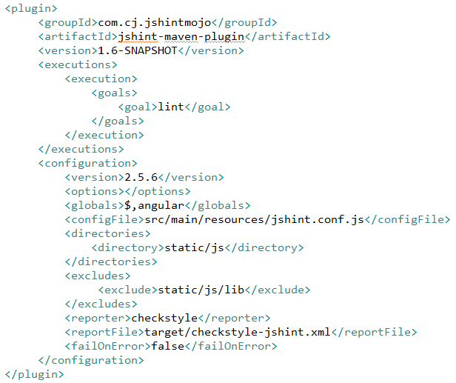
Integrate JSHint with Maven(contd)
Insert corresponding plugin element to pom.xml

Slide 17
1
JSHint Overview
2
JSHint Usage
3
How to Integrate JSHint with Maven
4
How to Integrate JSHint with Jenkins
Q & A
5

Slide 18
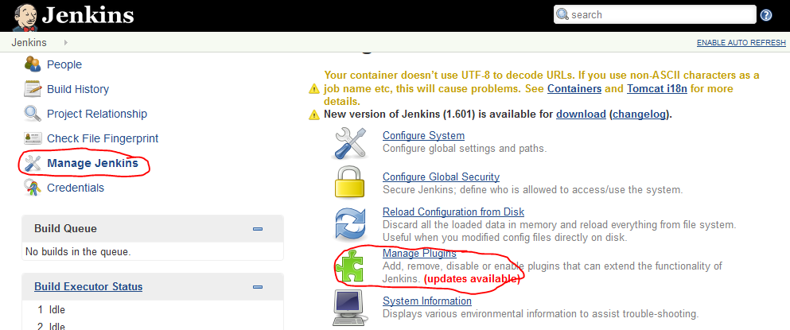
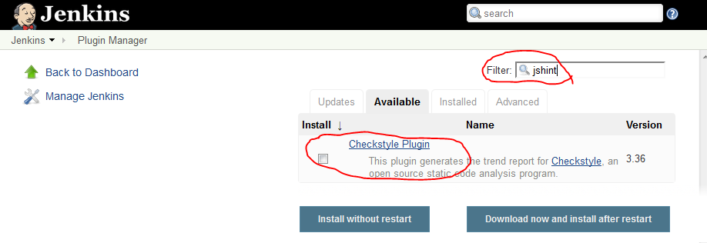
Integrate JSHint with Jenkins
‘Checkstyle Plugin’ is a necessary plugin for integrating JSHint with Jenkins.
Notes:
Currently, we are using Jenkins as our CI server. JSHint also provides a plugin to integrate with Jenkins.

Slide 19
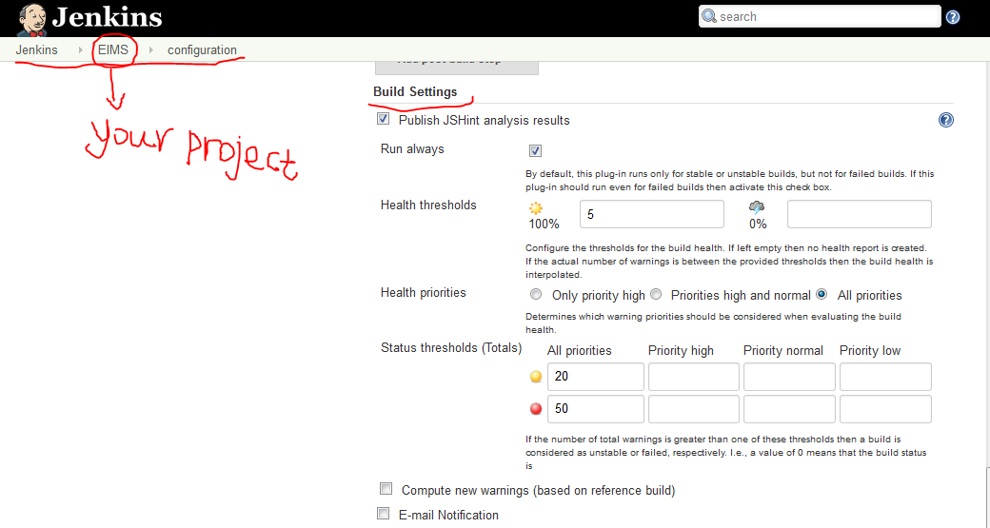
Integrate JSHint with Jenkins(contd)
Cutomize JSHint configuration in Jenkins

Slide 20
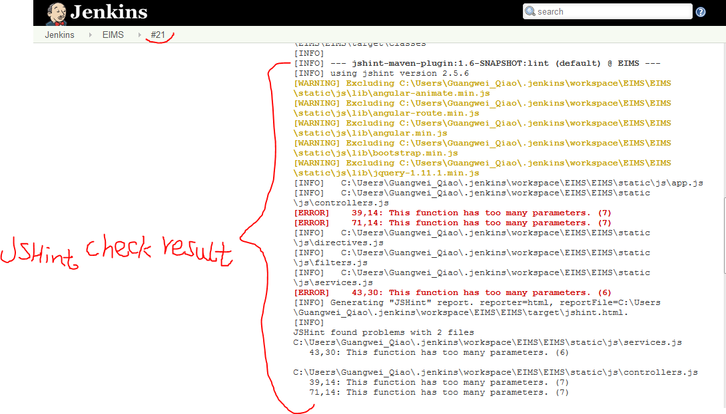
Integrate JSHint with Jenkins(contd)

Slide 21
References
JSHint source code https://github.com/jshint/jshint
JSHint Home: http://www.jshint.com/
JSHint Options: http://www.jshint.com/options/
Jshint-mojo https://github.com/cjdev/jshint-mojo
JSHint Wiki in Symweb: https://symweb.rmnus.sen.symantec.com/BnR/Appliance/Engineering/DocumentsTechnologyTrack/JSHint.docx

Slide 22
Q & A

